Slide 1
Credit Card Approval Machine Learning

Slide 2

INTRODUCTION
This presentation will cover a machine learning project on credit card approval.
The project aims to develop a model that can predict credit card approval based on various factors.
Machine learning algorithms will be used to train the model using historical credit card data.

Slide 3
Problem Statement
The problem is to predict credit card approval based on customer attributes and financial information.
The dataset consists of various features such as age, income, credit score, and employment status.
The goal is to build a model that can accurately predict whether an individual's credit card application will be approved or not.

Slide 4
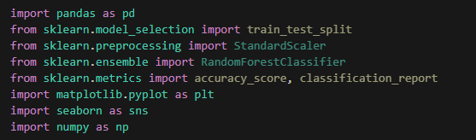
IMPORT LIBRARIES

Slide 5



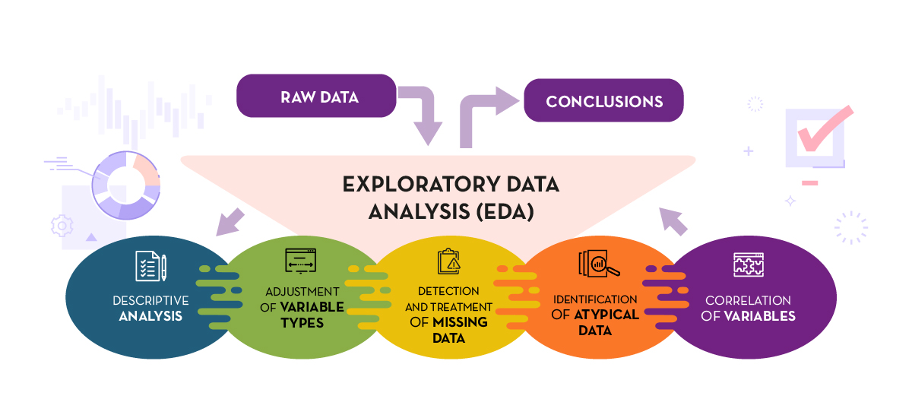
DATA EXPLORATION
The dataset will be explored to understand the distribution of features and identify any patterns or anomalies.
EDA will be done on the data to get a better understanding of it
Visualizations and statistical analysis will be performed to gain insights into the data.
Missing values and outliers will be handled appropriately to ensure data quality.

Slide 6
As we were given high risk as a targetted variable where 0 = No risk 1 = high risk In the Dataset if there is value ‘0’ means there is no risk and CC will be approved and vice-versa Hence we created an approval status column and there is no need of risk column anymore

Slide 7
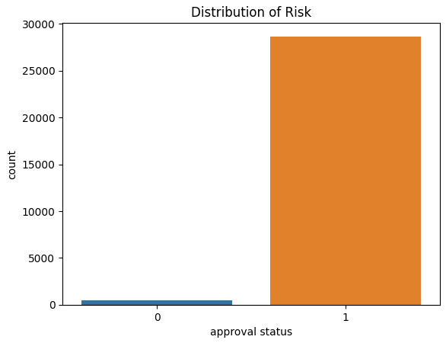
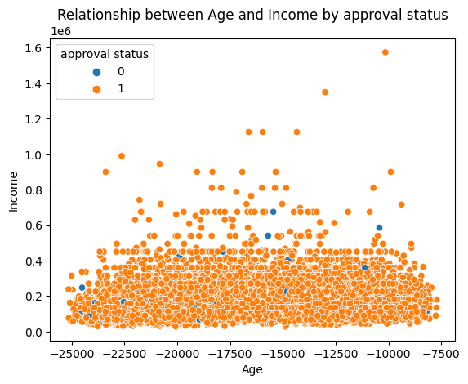
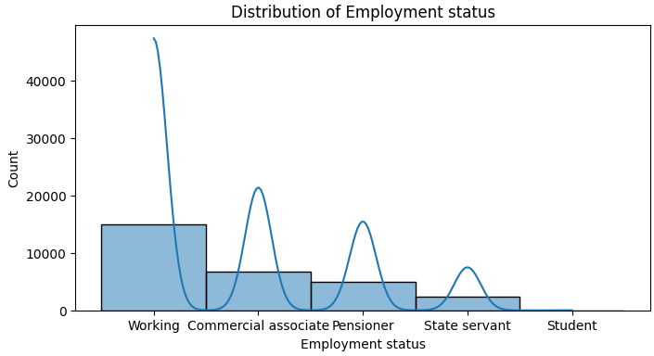
VISUALIZATIONS

Slide 8
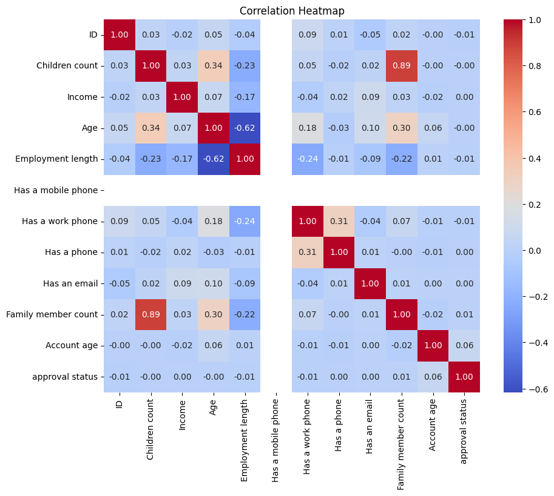

Slide 9
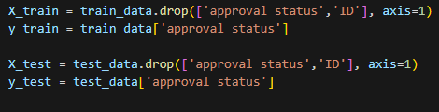
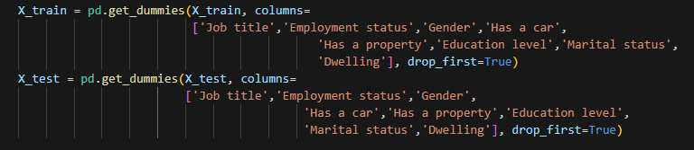

DATA PRE-PROCESSING
Data preprocessing involves handling missing values, encoding categorical variables, and normalizing numerical features.
Techniques like imputation, one-hot encoding, and scaling will be applied to prepare the data for machine learning algorithms.
The preprocessed data will be split into training and testing sets for model development and evaluation.

Slide 10
MODEL TRAINING
Several machine learning algorithms will be considered for credit card approval prediction.
Algorithms like logistic regression, decision trees, random forests, and support vector machines will be evaluated.
The selected model will be based on performance metrics such as accuracy, precision, recall, and F1-score.

Slide 11




MODEL TRAINING
Logistic Regression
Decision Trees
Random Forest
Gradient Boosting

Slide 12
MODEL EVALUATION
Visualizations like confusion matrices, ROC curves, and precision-recall curves will be used to illustrate the model's performance.
These visualizations provide a comprehensive understanding of the model's predictive power.
It helps stakeholders to make informed decisions based on the model's performance.
The trained model will be evaluated using the testing dataset.
Metrics such as accuracy, precision, recall, and F1-score will be calculated to assess its performance.
The model's ability to predict credit card approval accurately will be analyzed.

Slide 13




MODEL STATS
Logistic Regression
Decision Trees
Random Forest
Gradient Boosting

Slide 14

Feature Importance Analysis
The importance of features in predicting credit card approval will be analyzed.
Techniques like feature importance plots or permutation importance will be used to identify the most influential variables.
This analysis provides insights into which factors play a significant role in credit card approval.

Slide 15
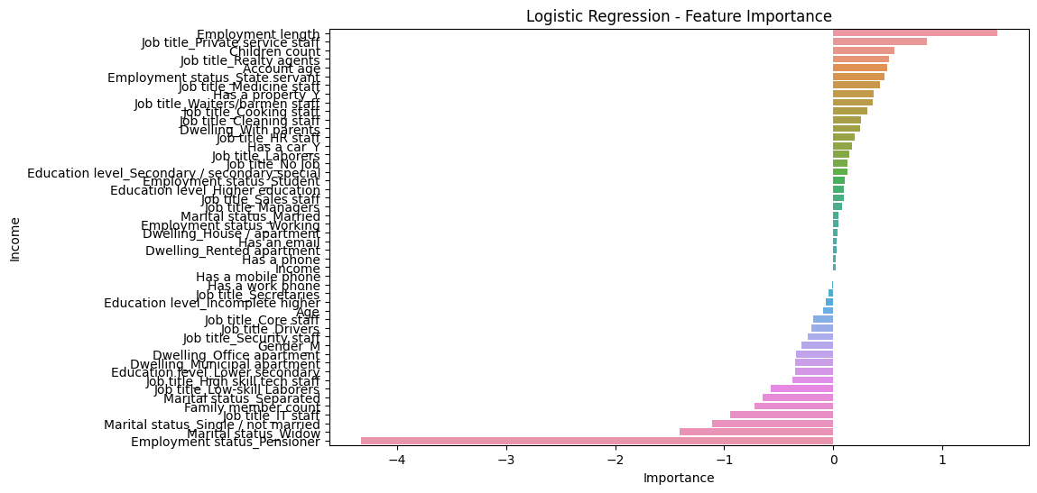

Slide 16
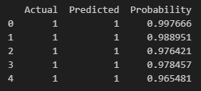
PREDICTION
Techniques will be used to interpret the model's predictions.
This helps explain how individual features contribute to the decision-making process.
Model interpretability is crucial for transparency and trust in credit card approval decisions.

Slide 17

Conclusion
The credit card approval machine learning project aims to develop a model that accurately predicts credit card approval.
Various steps like data exploration, preprocessing, model training, evaluation, and deployment are involved.
Continuous monitoring and updates are necessary to ensure the model's effectiveness over time.

